Slide 1

Practical project
By Muhamed Jakupovic

Slide 2
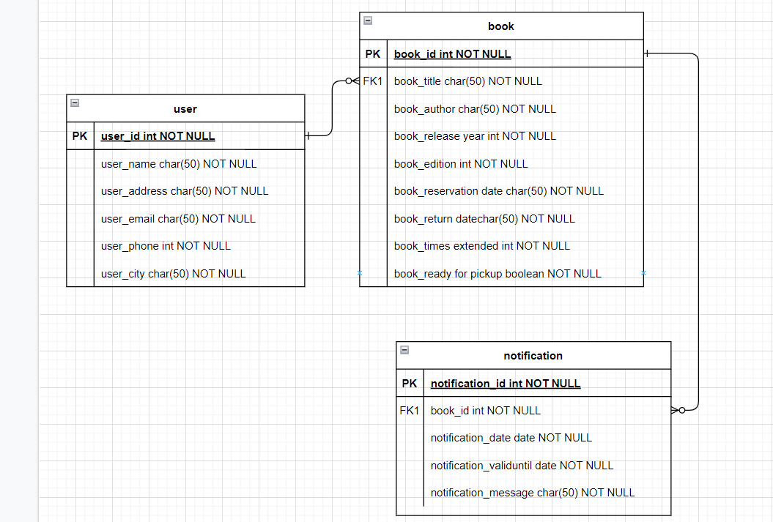
ERD diagram
Here you can see the ERD diagram that I created for my practical project. I made three items that each have a number of entities within them and some of these entities link together.

Slide 3
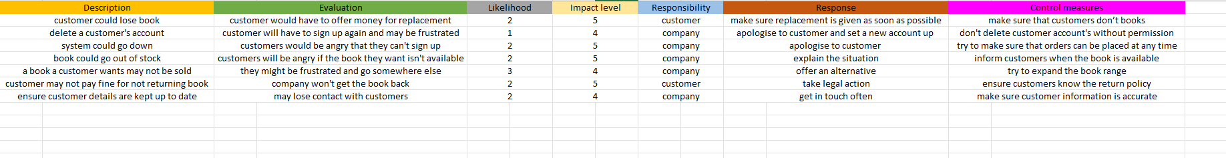
Risk assessment
Here you can see the risk assessment that I made for my practical project. These scenarios are possible events that could happen with the library system, such as a customer losing a book or a book going out of stock. This also highlights a number of different aspects, such as an evaluation, likelihood, impact level, responsibility, response and control measures.

Slide 4
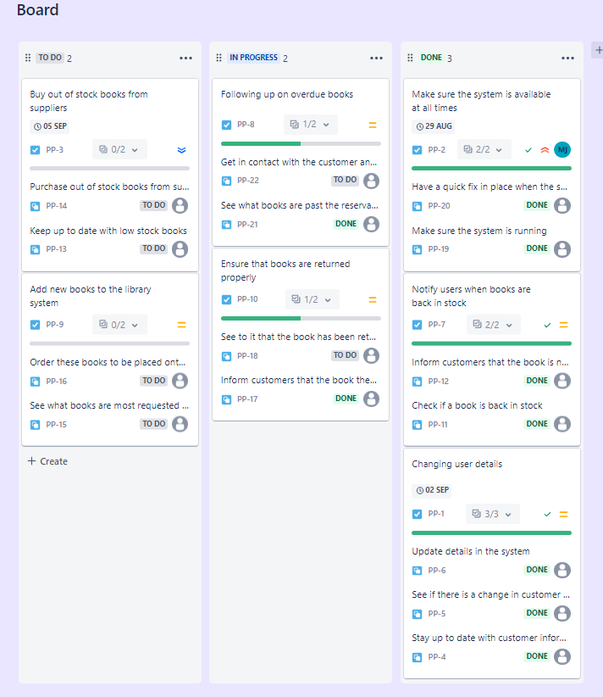
Jira board
Here is the jira board that I have created which has a number of tasks which has been split into three sections; to do, in progress and done. I have also made some child issues within the tasks and some of these have been completed whilst others have not.

